Slide 1

Funny Gorilla诙猩猩-IT培训
Your success is our success
Deployment Architecture

Slide 2
Agenda
Local browser
Remote browser – Selenium Grid
Standalone
Hub-Node
Fully Distributed
Cloud provider

Slide 3
Local browsers

Slide 4
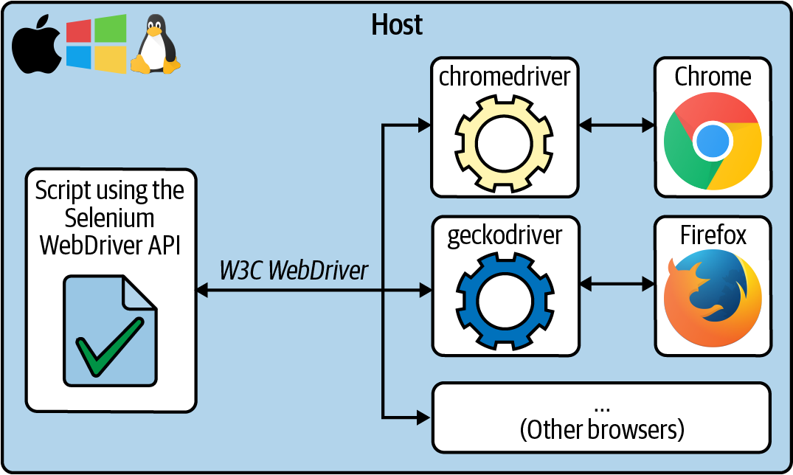
protocol

Slide 5
Remote browser
Selenium Grid
Cloud provider
Containerized Selenium Grid

Slide 6
In real life:
A remote environment:
Different Browser types
Different Versions
Different OS types
Parallel testing
A fleet of different browsers
with different versions
deployed in different OS
1
Selenium Grid
Remote browsers
2
Cloud provider
3
Containerized Selenium Grid

Slide 7
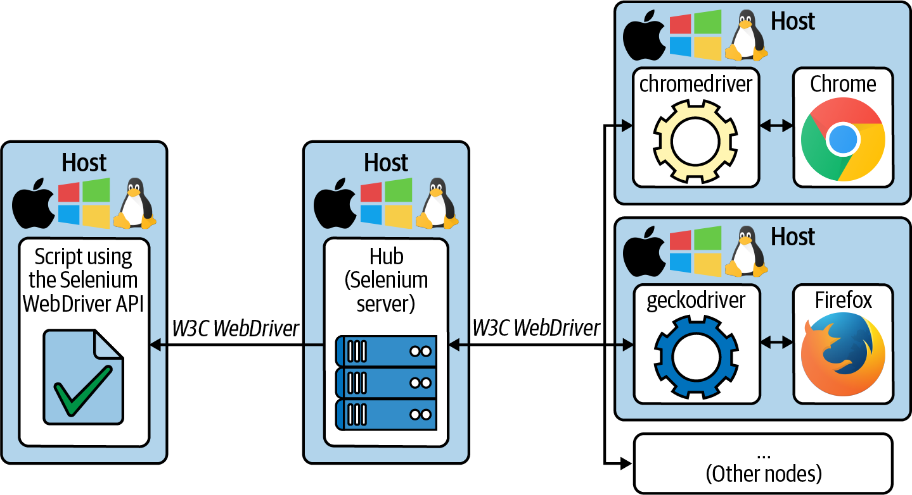
Cross browser testing
Parallel testing
protocol

Slide 8








Selenium Grid – Remote Browser
https://www.calculator.net/
Test Code
Web Application
Selenium Grid
POM
JSON/Http
Chrome
WebDriver
Safari
WebDriver
Firefox
WebDriver

Slide 9
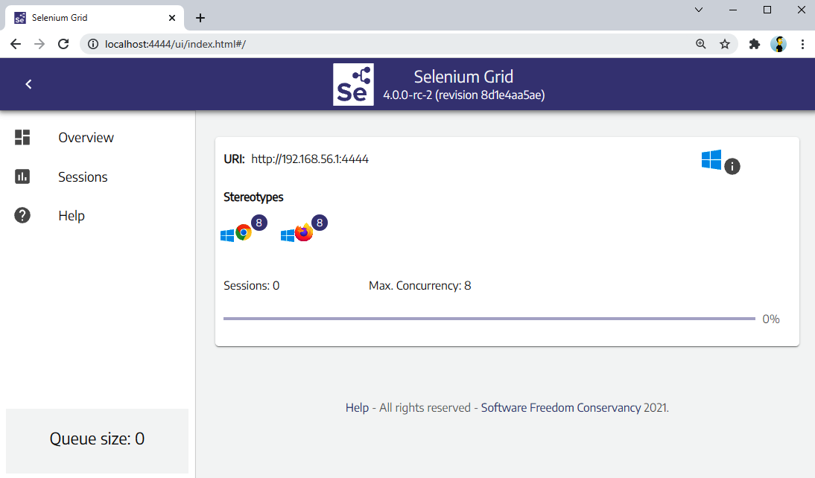
Selenium Grid
1
Standalone
2
Hub-nodes
3
Fully distributed

Slide 10
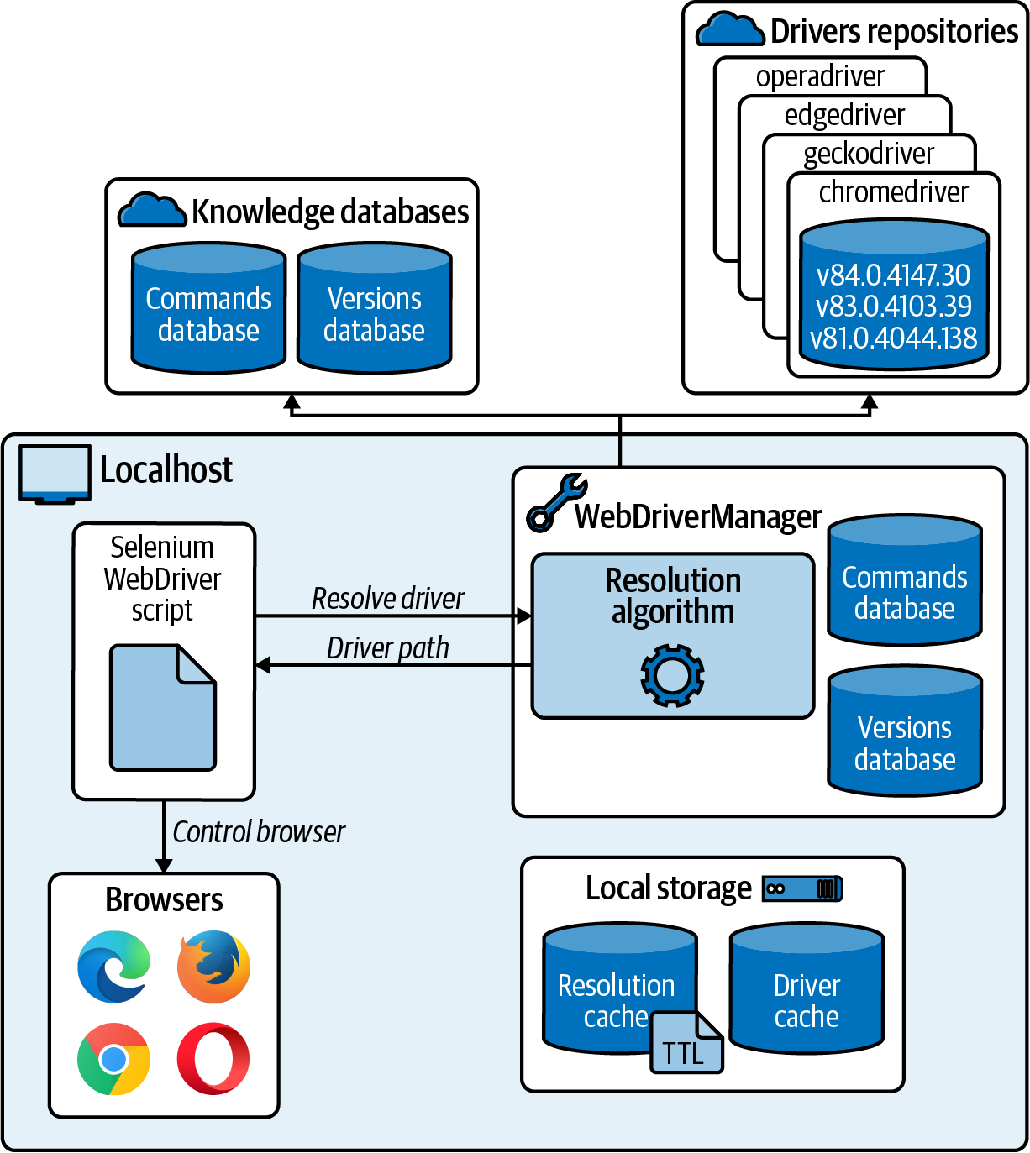
Standalone
java -jar webdrivermanager-5.0.3-fat.jar resolveDriverFor chrome
java -jar selenium-server-4.0.0.jar standalone
WebDriver driver = new RemoteWebDriver("http://localhost:4444/", new ChromeOptions());

Slide 11
Hub-Node
java -jar selenium-server-4.0.0.jar hub
java -jar selenium-server-4.0.0.jar node –hub http://xxxx:4444
WebDriver driver = new RemoteWebDriver("http://localhost:4444/", new ChromeOptions());

Slide 12
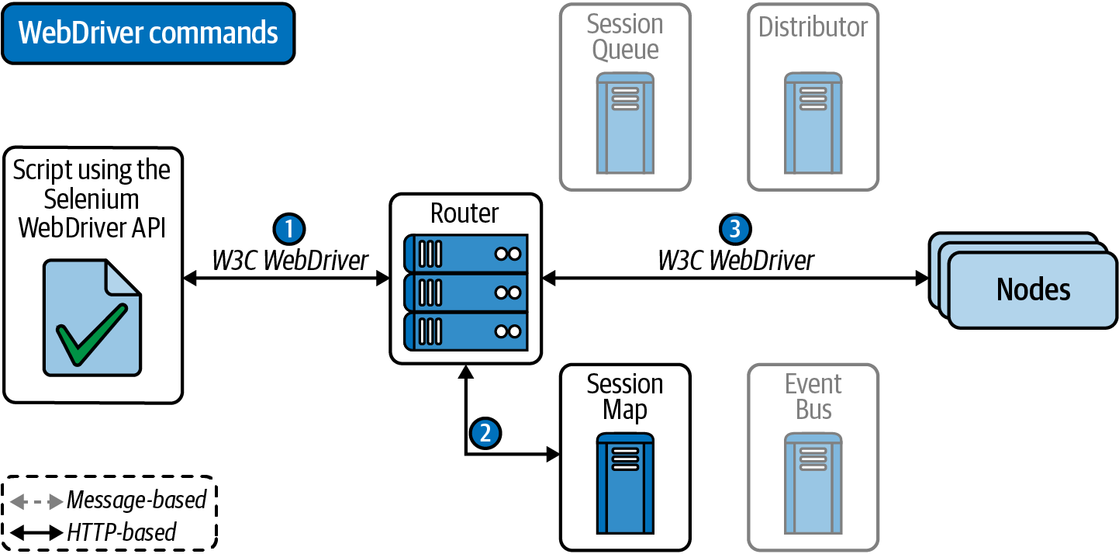
Fully Distributed
WebDriver driver = new RemoteWebDriver("http://localhost:4444/", new ChromeOptions());

Slide 13
Router: Acts as the gateway for the grid, receiving external requests and directing them to the right component for handling.
Distributor: Manages the registration and capabilities of Nodes in the grid. It also assigns new session requests to the appropriate Nodes from the Session Queue and updates the Grid’s model with Node status
Session Map: Stores the links between Session IDs and Nodes, facilitating efficient request routing by the Router.
Session Queue: Holds incoming session requests in a First In, First Out (FIFO) order. It includes settings for request timeouts and retry intervals, ensuring organized and efficient processing of requests.
Node: Executes tests within a distributed network. To receive appropriate test requests, Nodes with specific configurations must register with the Distributor.

Slide 14
Containerized Selenium Grid

Slide 15
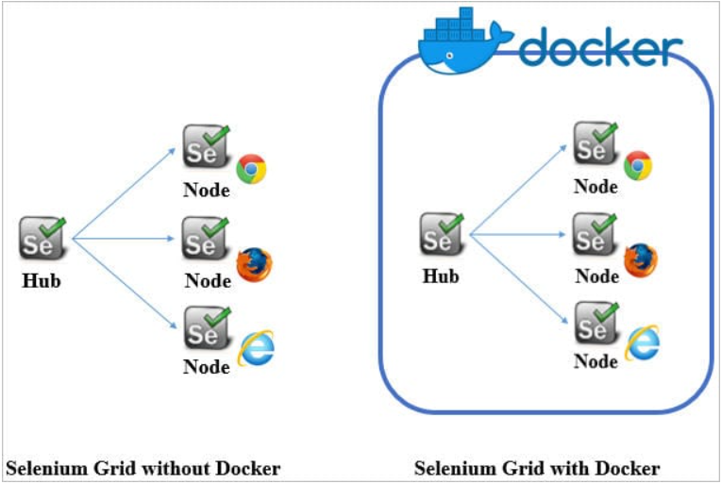

Slide 16
Demo Selenium Grid

Slide 17
Cloud Providers
Notes:
To request on-demand web browsers hosted by the providers. These browsers are usually of different types, versions, and operating systems. This feature is typically used for cross-browser automated or live testing.
To monitor and debug automated tests. To that aim, cloud providers typically support session recordings or rich error-reporting features.
To request emulated (and real) mobile devices on different platforms, such as Android and iOS.
Automatically inspect the UI and ensure that end users have a correct visual experience.

Slide 18
Values
Browsers as a service
Analysis capabilities
Mobile testing
Visual testing
Notes:
To request on-demand web browsers hosted by the providers. These browsers are usually of different types, versions, and operating systems. This feature is typically used for cross-browser automated or live testing.
To monitor and debug automated tests. To that aim, cloud providers typically support session recordings or rich error-reporting features.
To request emulated (and real) mobile devices on different platforms, such as Android and iOS.
Automatically inspect the UI and ensure that end users have a correct visual experience.

Slide 19
Providers
Sauce Labs,
BrowserStack,
LambdaTest,
CrossBrowserTesting,
Moon Cloud,
TestingBot,
Perfecto, or
Testinium
Notes:
To request on-demand web browsers hosted by the providers. These browsers are usually of different types, versions, and operating systems. This feature is typically used for cross-browser automated or live testing.
To monitor and debug automated tests. To that aim, cloud providers typically support session recordings or rich error-reporting features.
To request emulated (and real) mobile devices on different platforms, such as Android and iOS.
Automatically inspect the UI and ensure that end users have a correct visual experience.

Slide 20
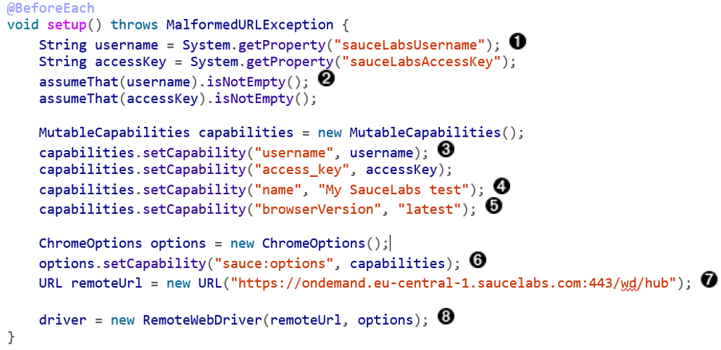
Sample Code

Slide 21
Put Everything Together

Slide 22
Selenium Environment Setup – Standalone Grid
Download Seleniue Grid
https://www.selenium.dev/downloads/
Download Chrome Driver
https://chromedriver.chromium.org/downloads
Download and configure Maven
https://maven.apache.org/download.cgi
Prepare eclipse
https://www.browserstack.com/guide/selenium-with-java-for-automated-test

Slide 23
References
Maven
Eclipse
https://www.vogella.com/tutorials/Eclipse/article.html
Java
XPath
https://www.guru99.com/xpath-selenium.html
Selenium tutorial
https://www.selenium.dev/documentation/webdriver/getting_started/
https://www.browserstack.com/guide/selenium-with-java-for-automated-test
https://www.tutorialspoint.com/selenium/selenium_webdriver.htm
https://www.lambdatest.com/blog/selenium-webdriver-tutorial-with-examples/
Code sample
https://www.lambdatest.com/blog/selenium-webdriver-tutorial-with-examples/

Slide 24

Contact
WebSite: www.funnygorilla.com.au
Mail: info@funnygorilla.com.au
Linkedin: https://mt.linkedin.com/in/songqing-gu-2ba9034b/de
WebChat: Funny Training Gorilla
Phone: 0420891343

